Slide 1
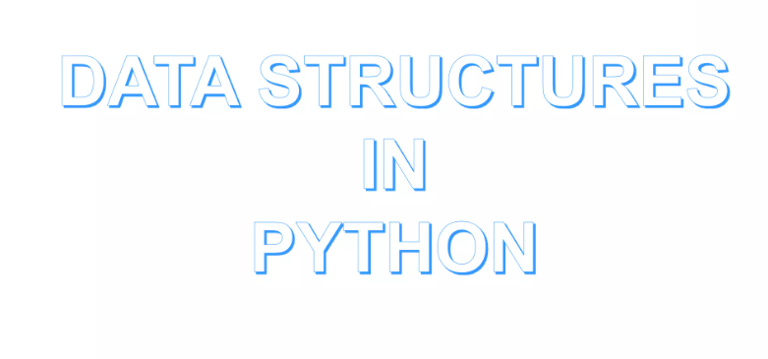

Slide 2
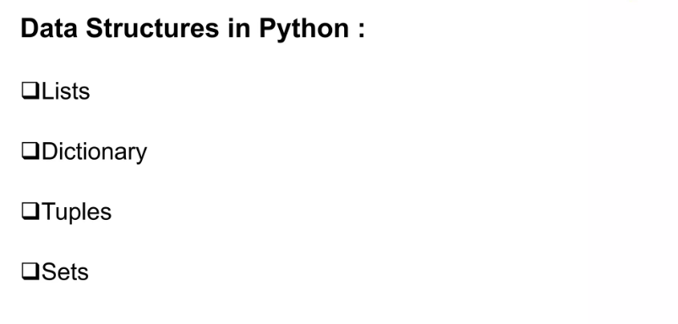

Slide 3
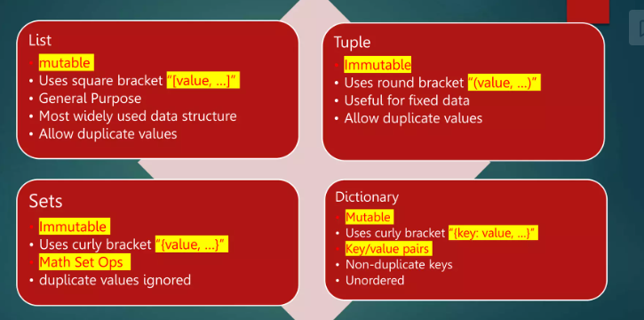

Slide 4
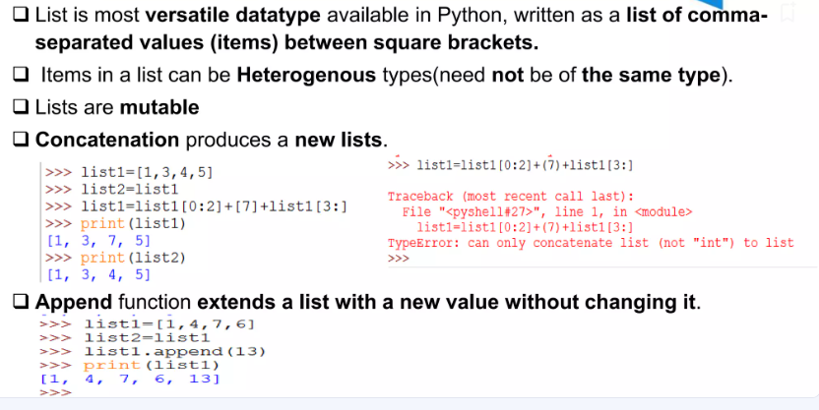

Slide 5
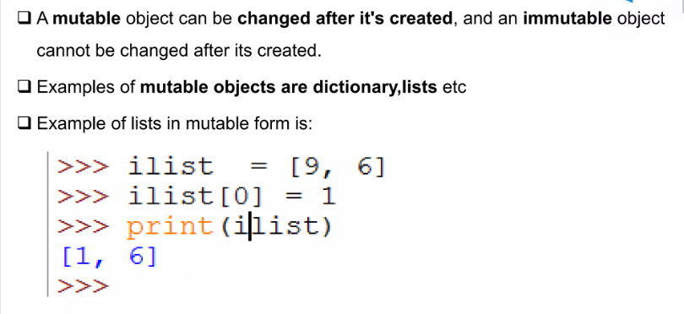
Lists are Mutable

Slide 6
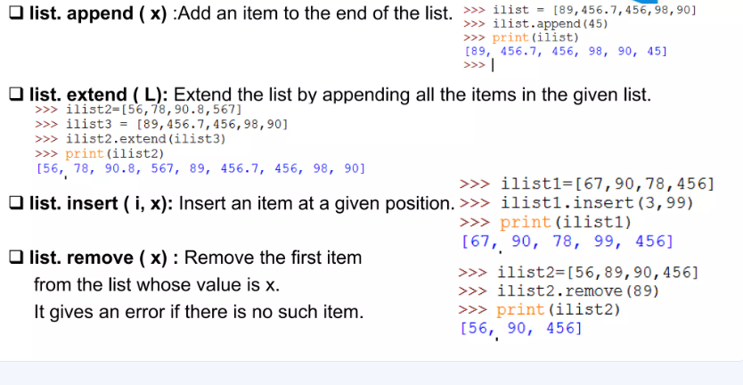
List Functions

Slide 7
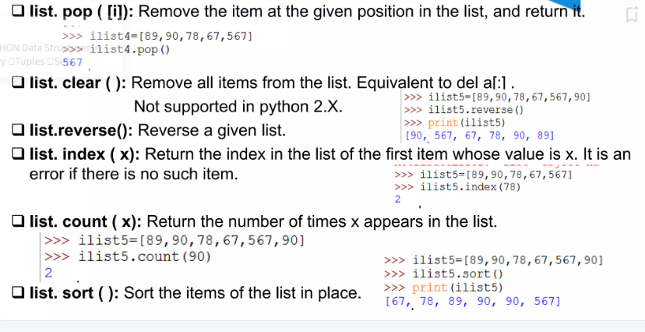
List Functions

Slide 8
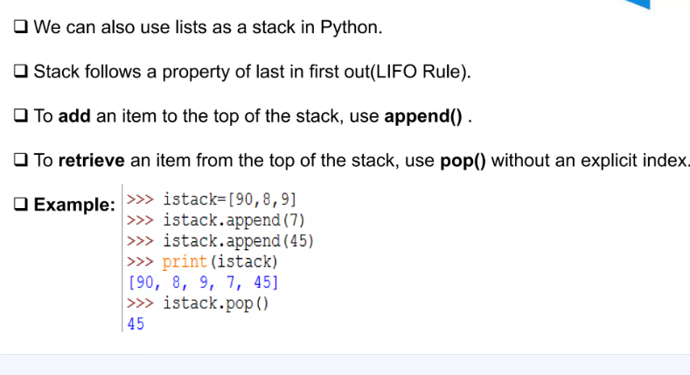
Using List as a Stack

Slide 9
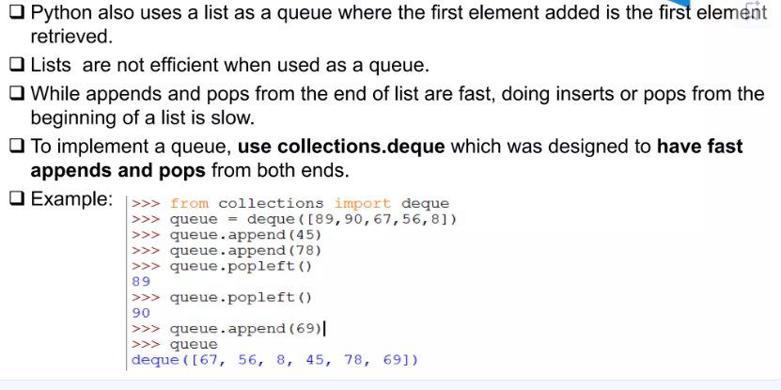
Using List as Queue

Slide 10
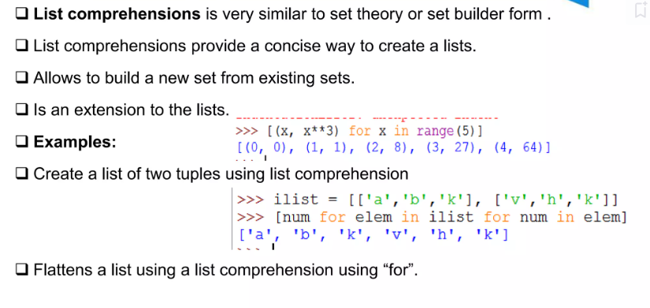
List Comprehension

Slide 11
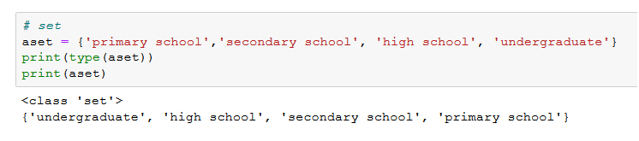
Data Structure 4: Sets in Python
Sometimes, we don’t want multiple occurrences of the same element in our list or tuple.
It is here that you can use a set data structure.
A Set is an unordered but mutable collection of elements that contains only unique values.

Slide 12
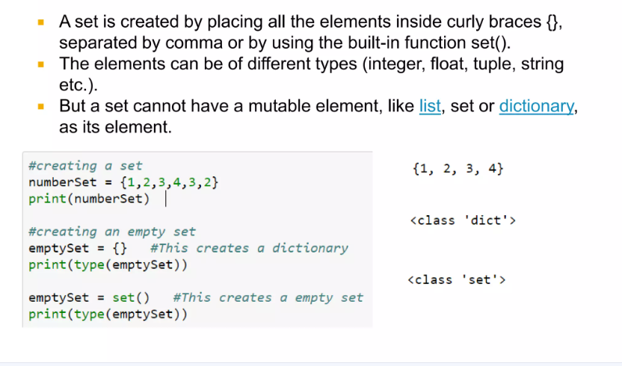
Creating a Set

Slide 13
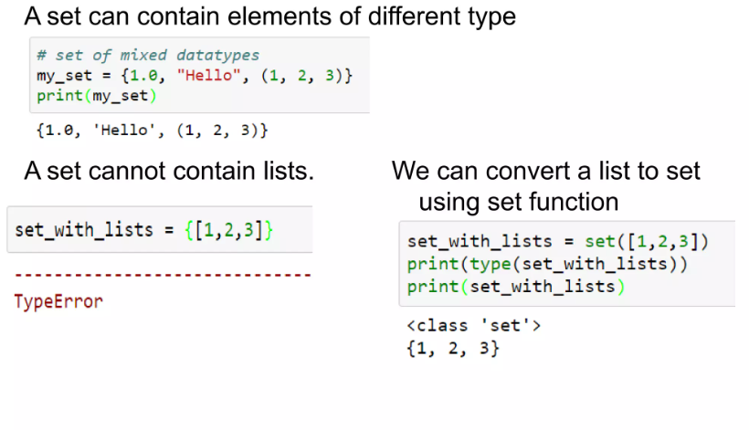

Slide 14
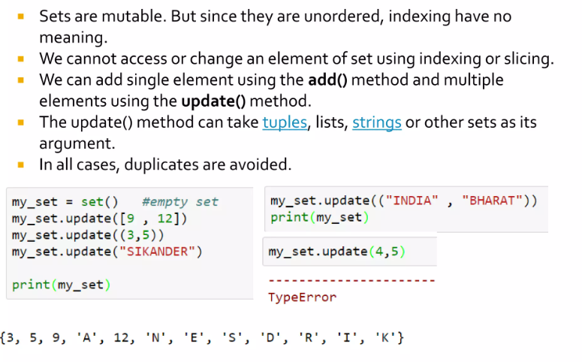
Adding Elements to Set

Slide 15
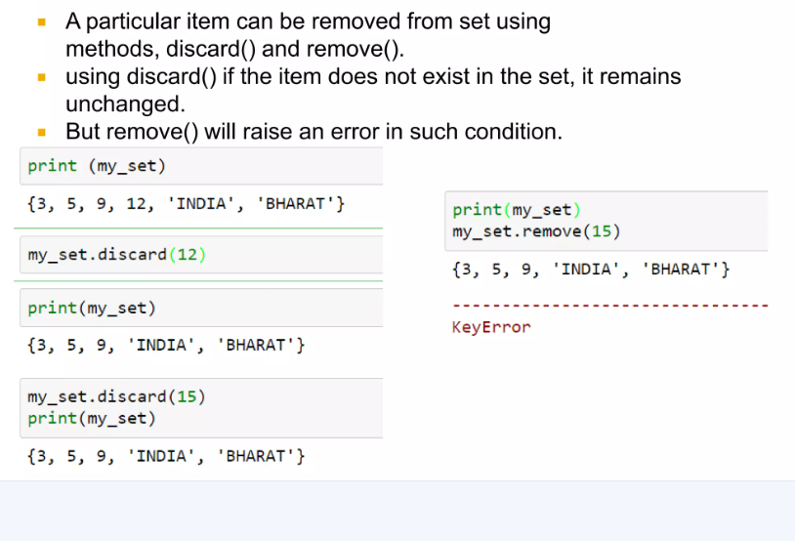
Remove Elements from set

Slide 16
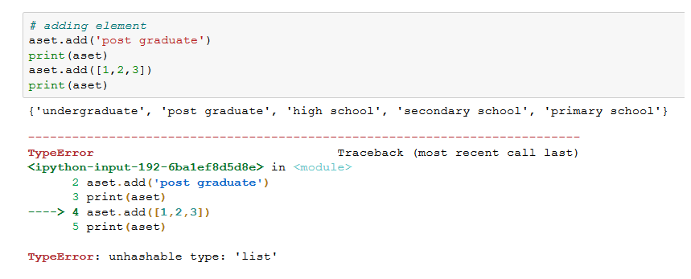
Add and Remove Elements from a Set
To add values to a set, use the add() method. It lets you add any value except mutable objects.

Slide 17
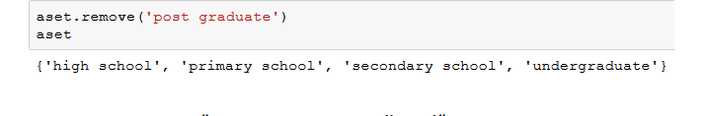
Removing Values from set
The first is the remove() method, which gives an error if the element is not present in the Set
The second is the discard() method, which removes elements but gives no error when the element is not present in the Set

Slide 18
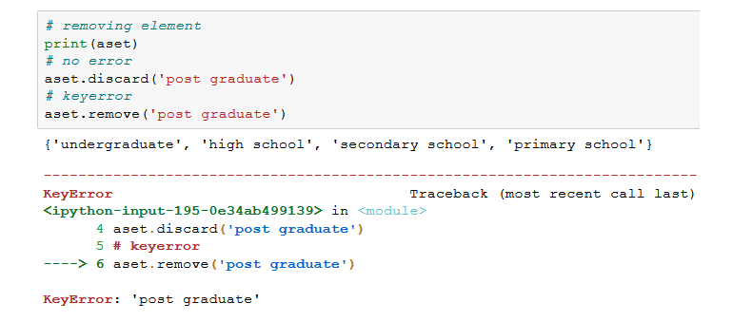
If the value does not exist, remove() will give an error, but discard() won’t.

Slide 19
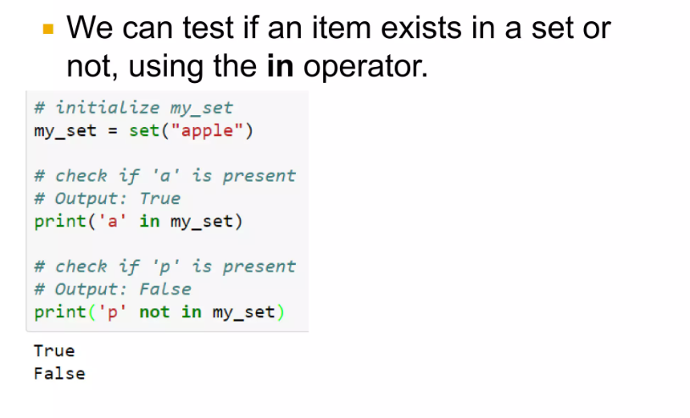

Set Membership Test

Slide 20
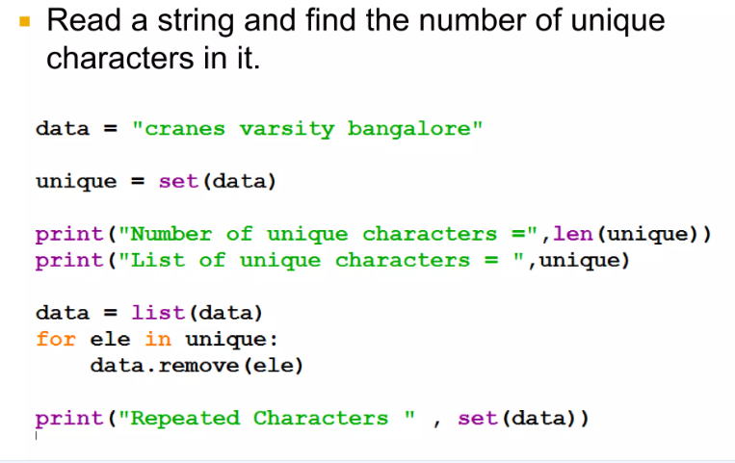

Slide 21
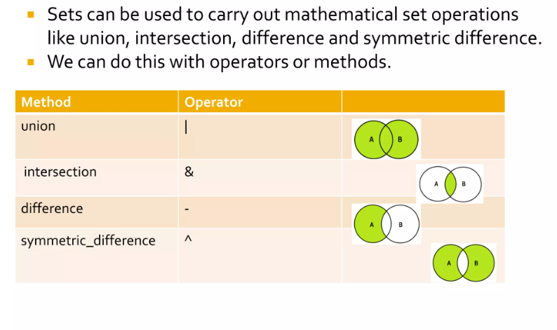
Set Operations

Slide 22
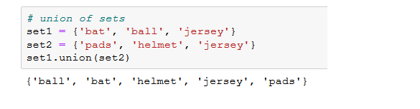
Union
The Union of two sets gives values from both sets. But the values are unique. So if both the sets contain the same value, only one copy will be returned:

Slide 23
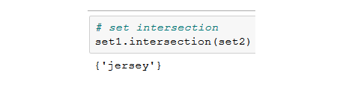
Intersection
The Intersection of two sets returns only those values that are common to both sets:

Slide 24
Difference in sets
The difference() method returns a set that contains the difference between two sets.
Meaning: The returned set contains items that exist only in the first set, and not in both sets.
Syntax
set.difference(set)

Slide 25
x = {"apple", "banana", "cherry"} y = {"google", "microsoft", "apple"} z = x.difference(y) print(z)
Output: {'cherry', 'banana'}

Slide 26
x = {"apple", "banana", "cherry"} y = {"google", "microsoft", "apple"} z = y.difference(x) print(z)

